Slide 1
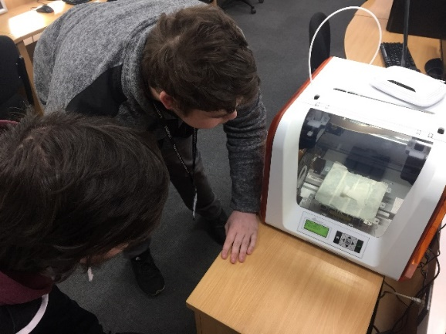
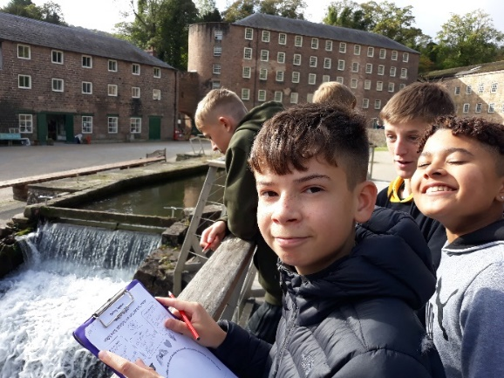
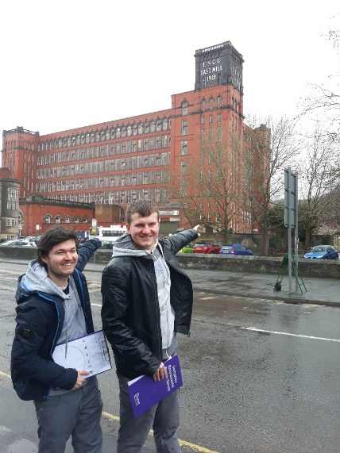
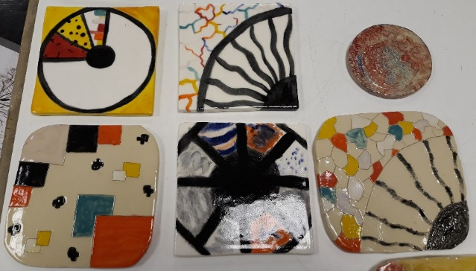
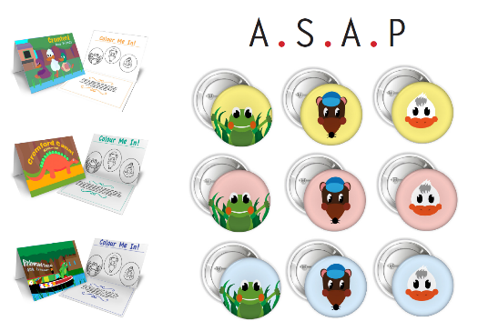
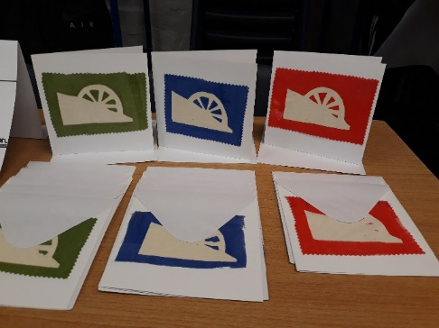
YOUNG ENTREPRENEURS

Slide 2
What’s it all about?
This is an exciting opportunity to provide young people aged 11-18 with a real opportunity to engage with, be inspired by and respond to the East Midlands’ only World Heritage Site.
It will provide an opportunity to give young people living within and around the Derwent Valley Mills World Heritage Site (DVMWHS) the opportunity to develop their creativity, employability and teamwork skills in an innovative and engaging way.
Essentially this means you will work in small groups to make a product (digital or physical) inspired by the DVMWHS; this product will be either sold to the general public or assessed by industry experts.

Slide 3
How will the project work in practice?
By the end of today:
Chosen a site for the whole group to focus on
Decided on what type of product to make
Formed small groups – thought of a ‘company name’ and discussed the ‘tenner challenge’

Slide 4
In the following weeks and months:
Site tour and inspiration visit, possibly with a creative expert
Production development and manufacture, possibly with a creative expert.
Continued manufacture and preparation for ‘sales’ event
‘Sales’ event

Slide 5
What is the ‘tenner challenge’?
Each ‘company’ will be given £10 to invest in their product.
This £10 can be used to buy additional materials or resources needed to help develop and manufacture their product.
Different companies can ‘pool’ their money together to increase purchasing power.
Each company will also have access to the materials and equipment available at your location
https://www.tenner.org.uk/

Slide 6
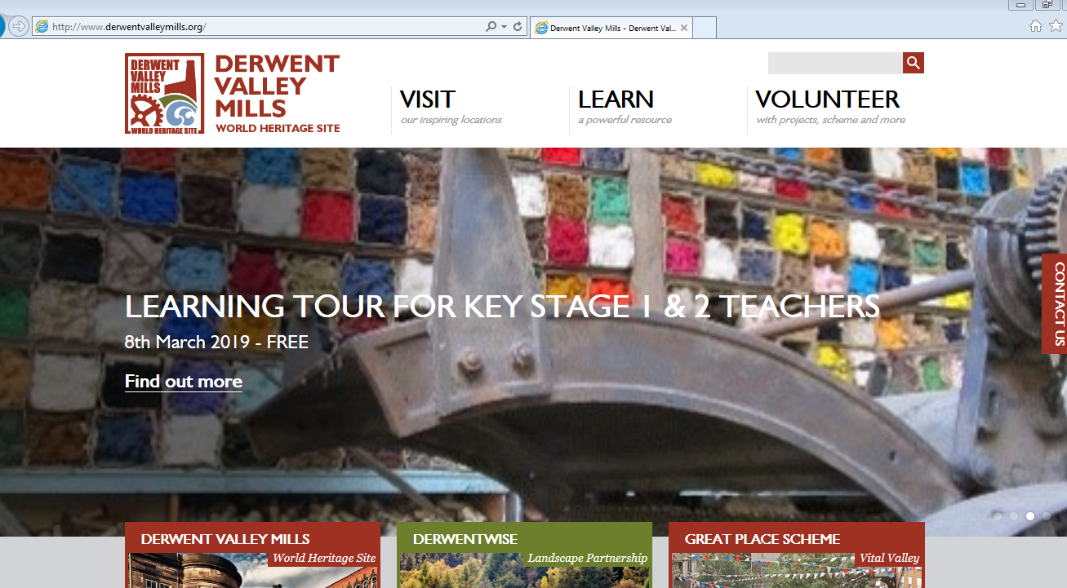
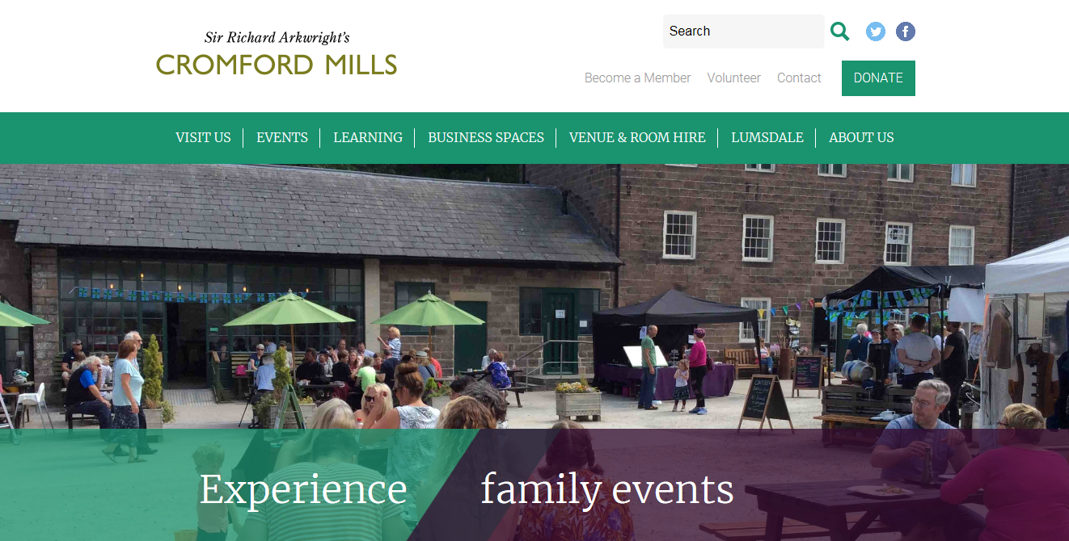
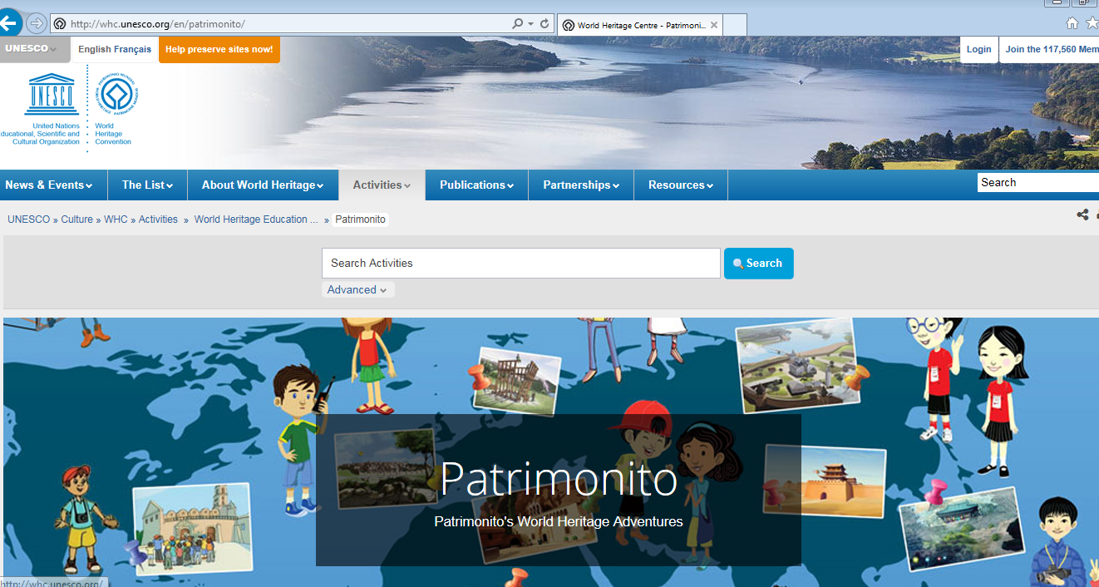
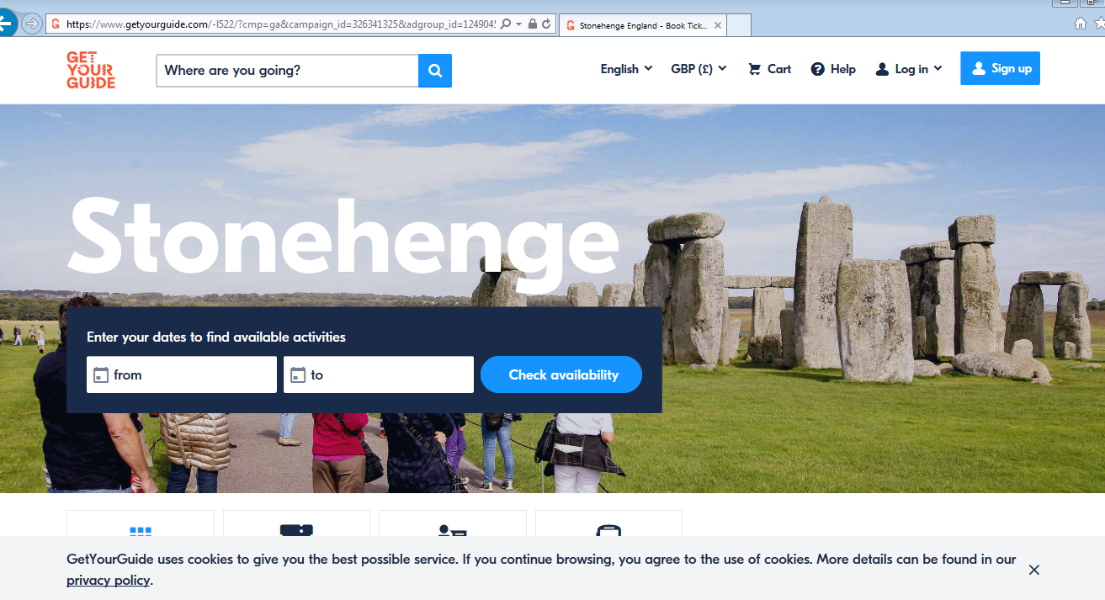
You could create digital products:
Example products: Websites

Slide 7
Example products: Animations

Slide 8
Example products: Animations

Slide 9
Example products: Modelling

Slide 10
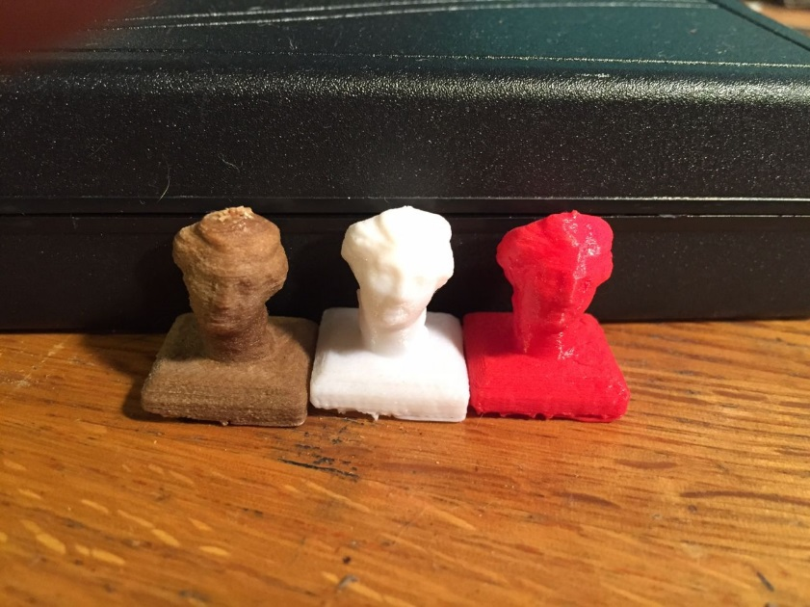
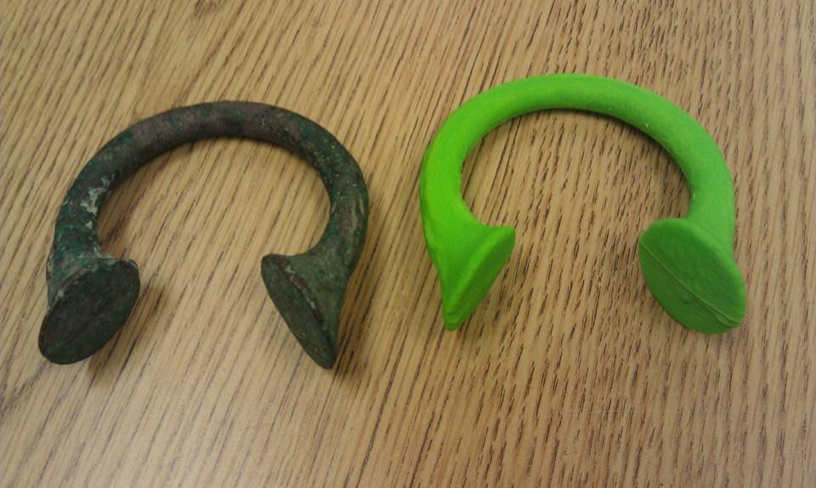
Example products: 3-D printing

Slide 11
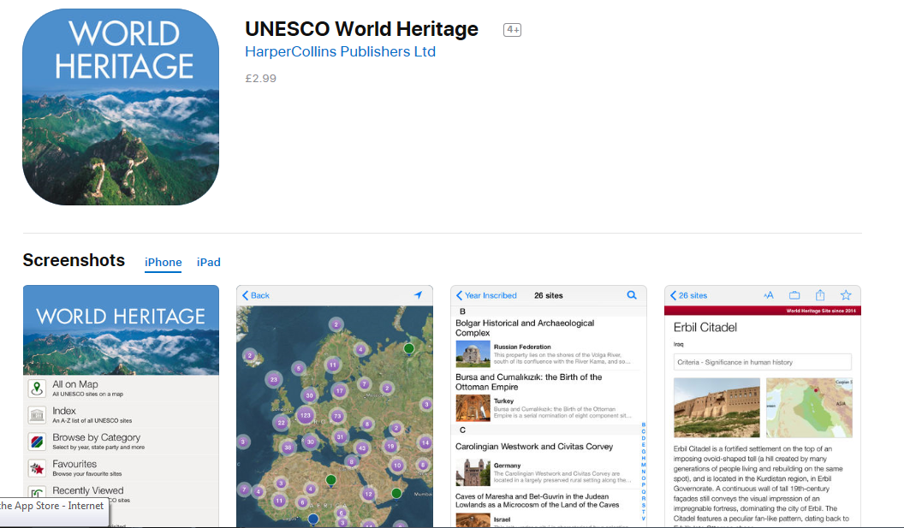
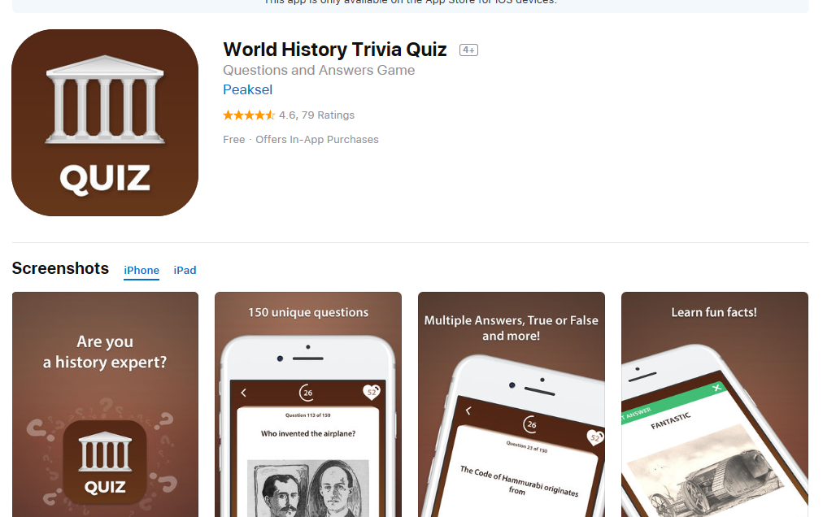
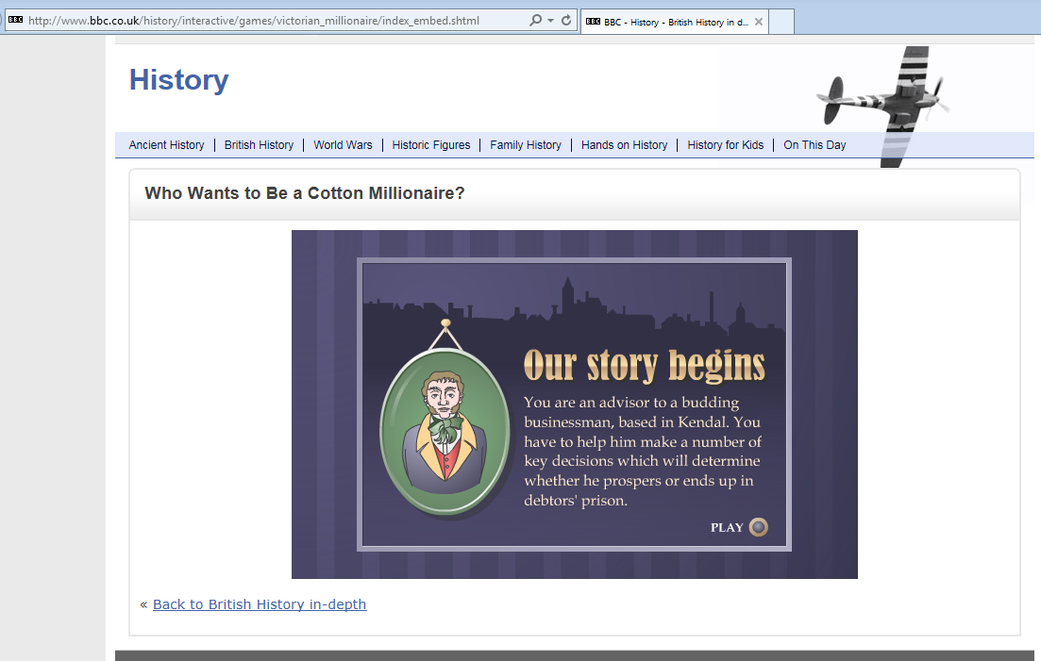
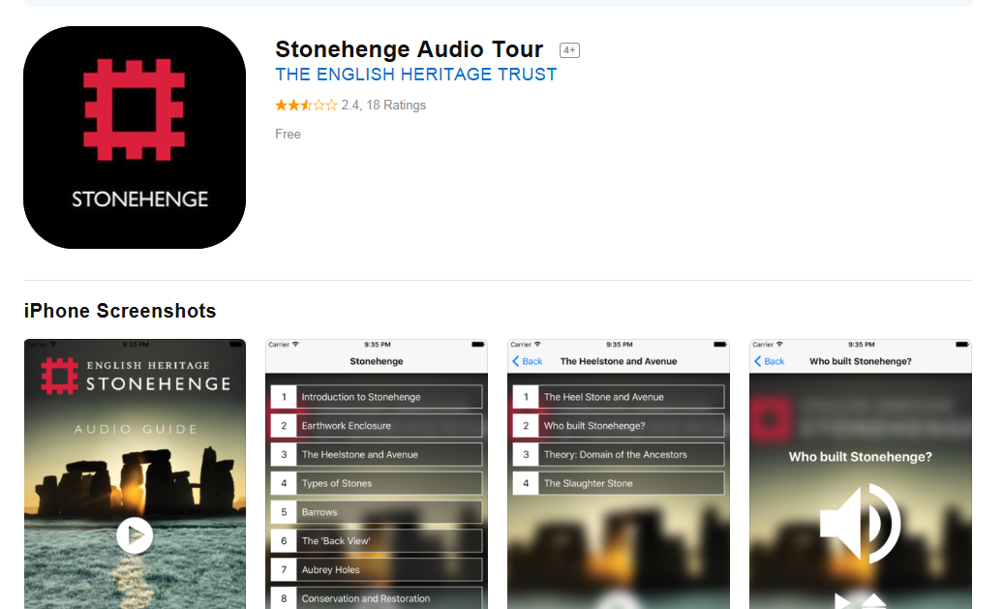
Example products: Games and Apps
http://www.bbc.co.uk/history/interactive/games/victorian_millionaire/index_embed.shtml

Slide 12
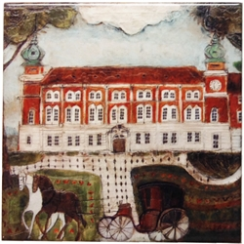
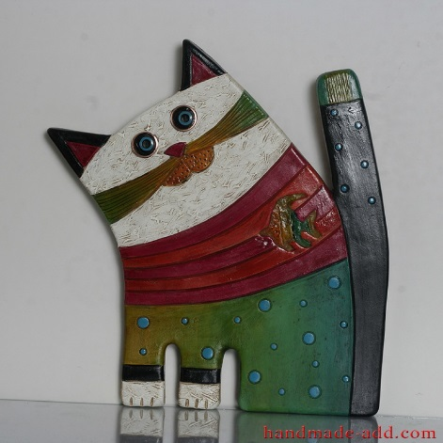
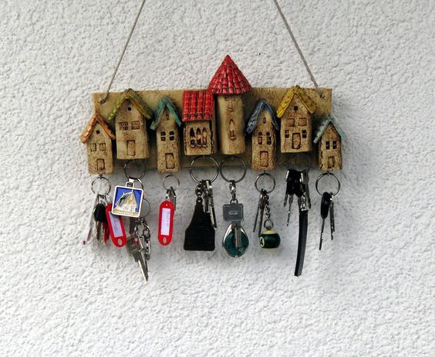
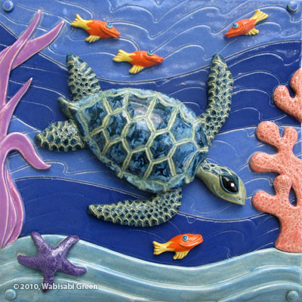
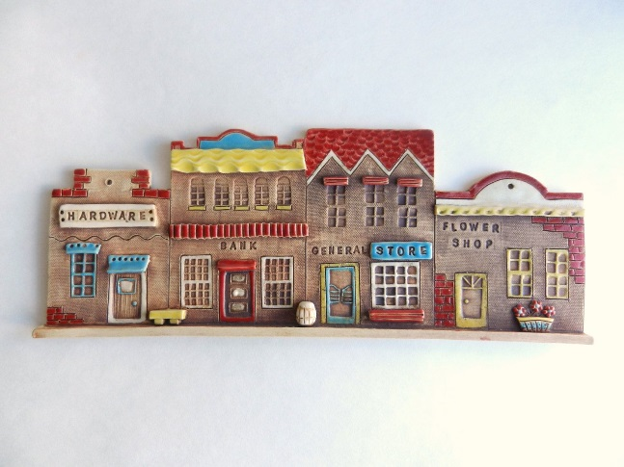
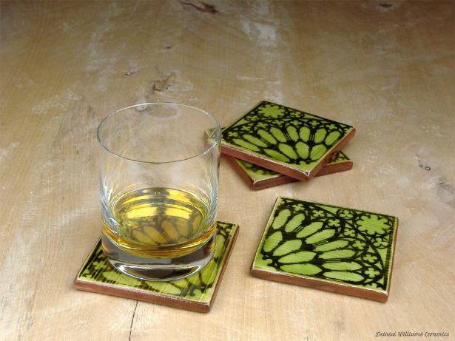
Working in Clay:
Example products

Slide 13
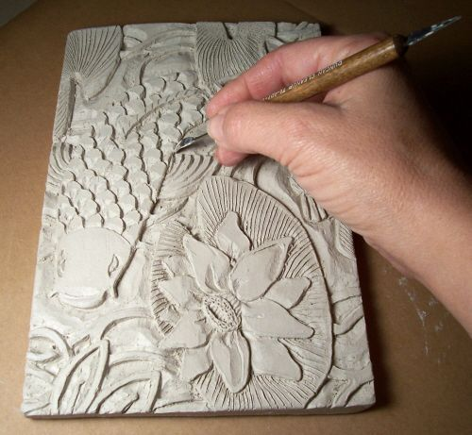
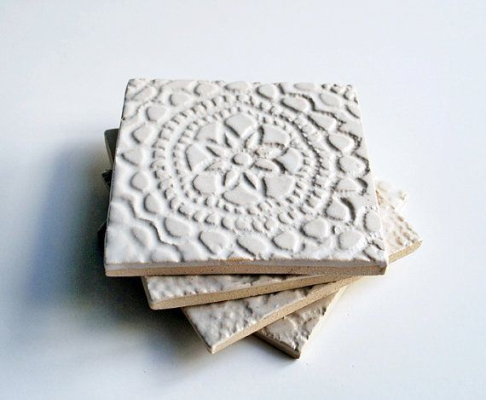
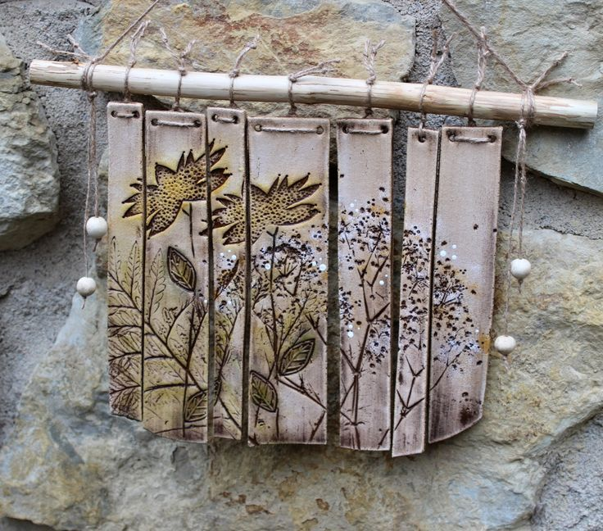
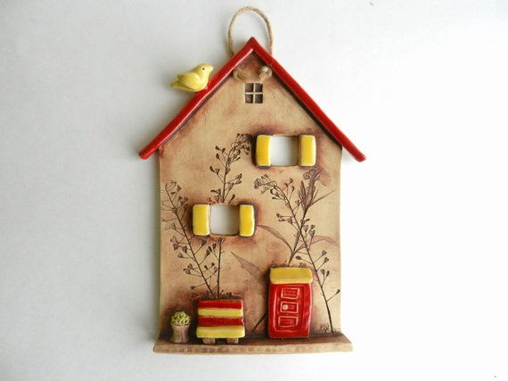
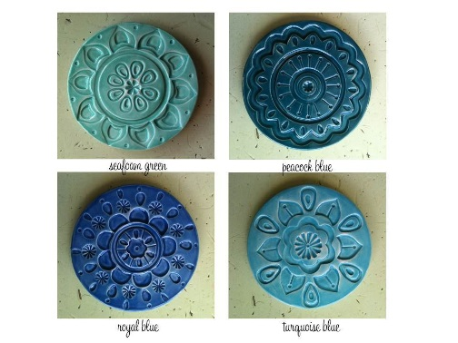

Slide 14
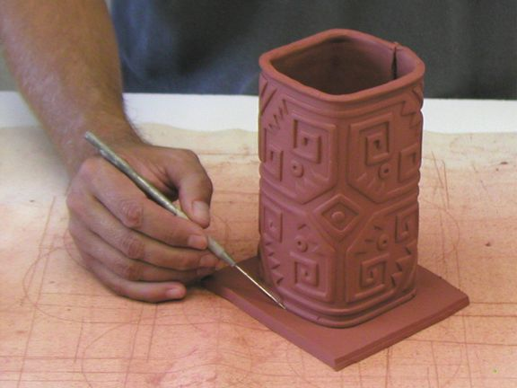
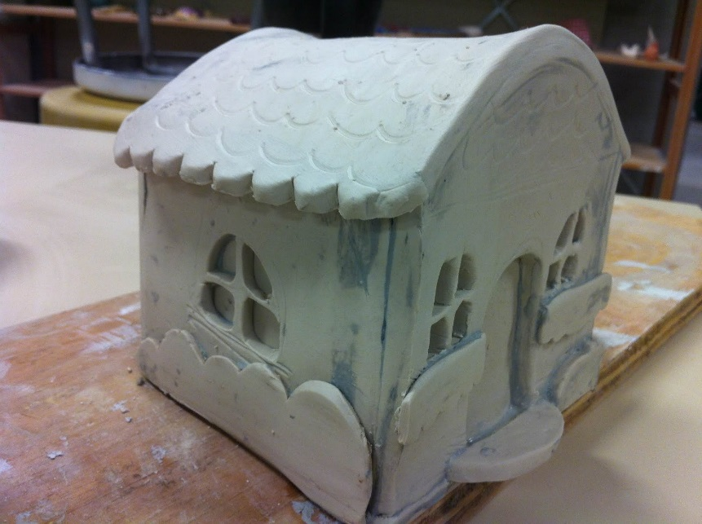
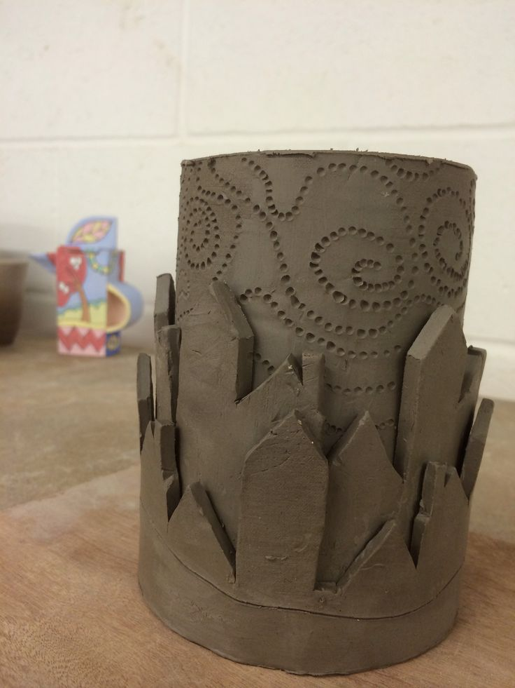
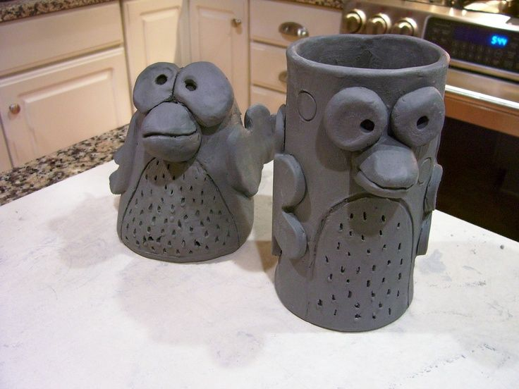
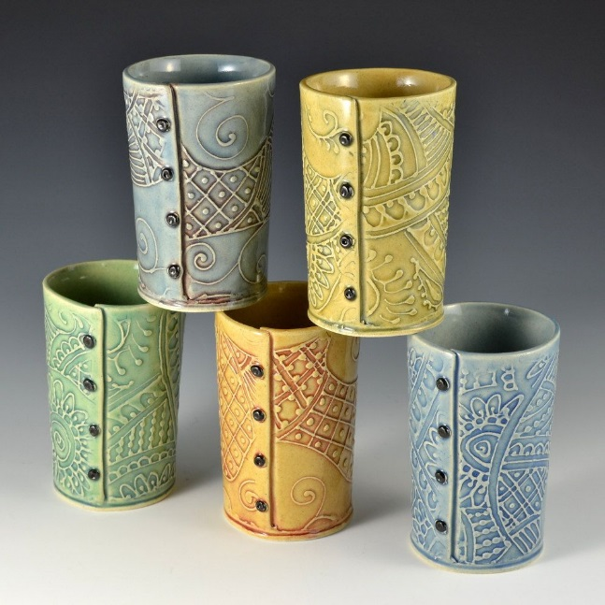

Slide 15
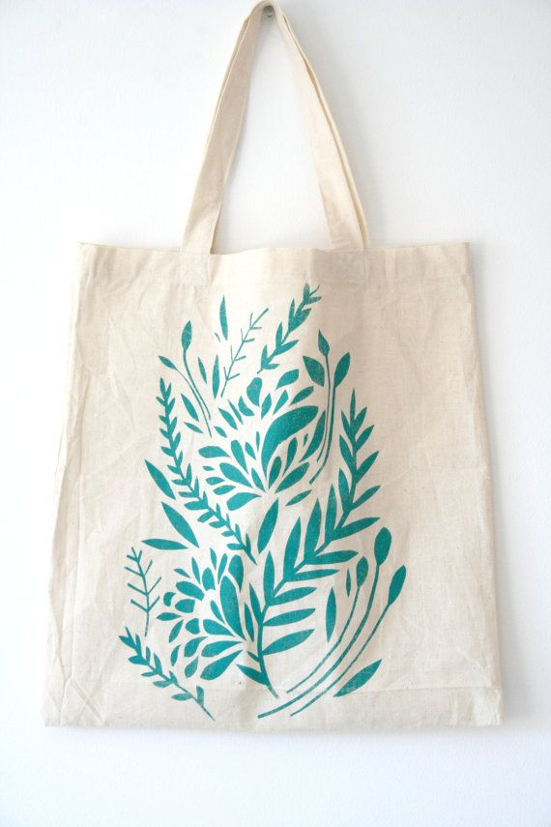
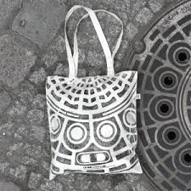
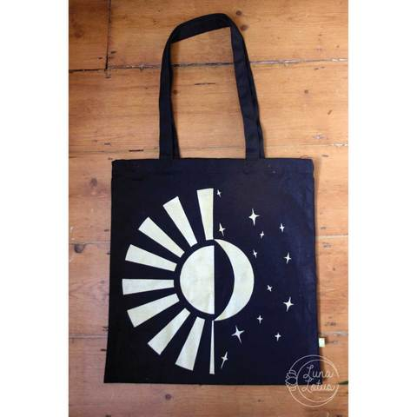
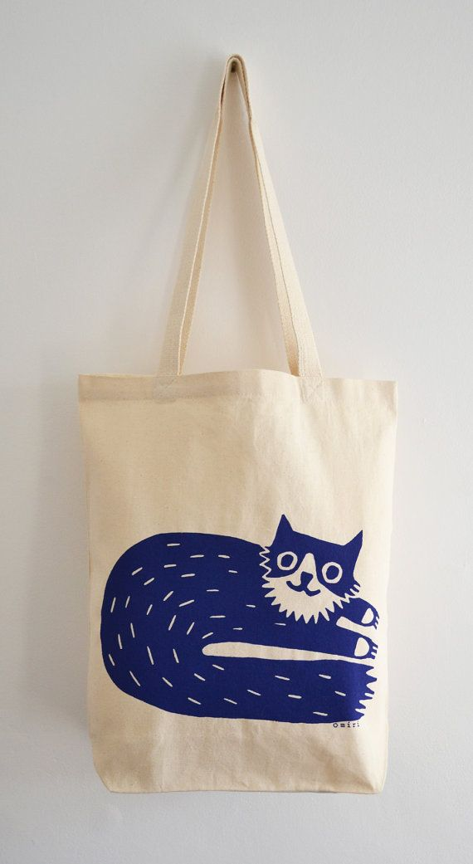
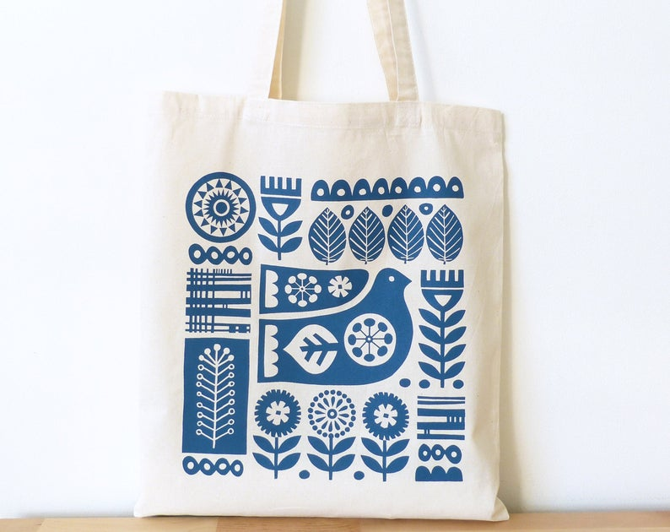
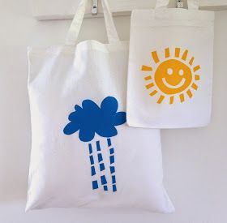
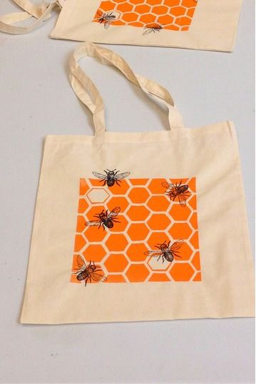
Screen Printing:
https://www.youtube.com/watch?v=ND1AUJhdUZc (5 mins to 8 mins)

Slide 16
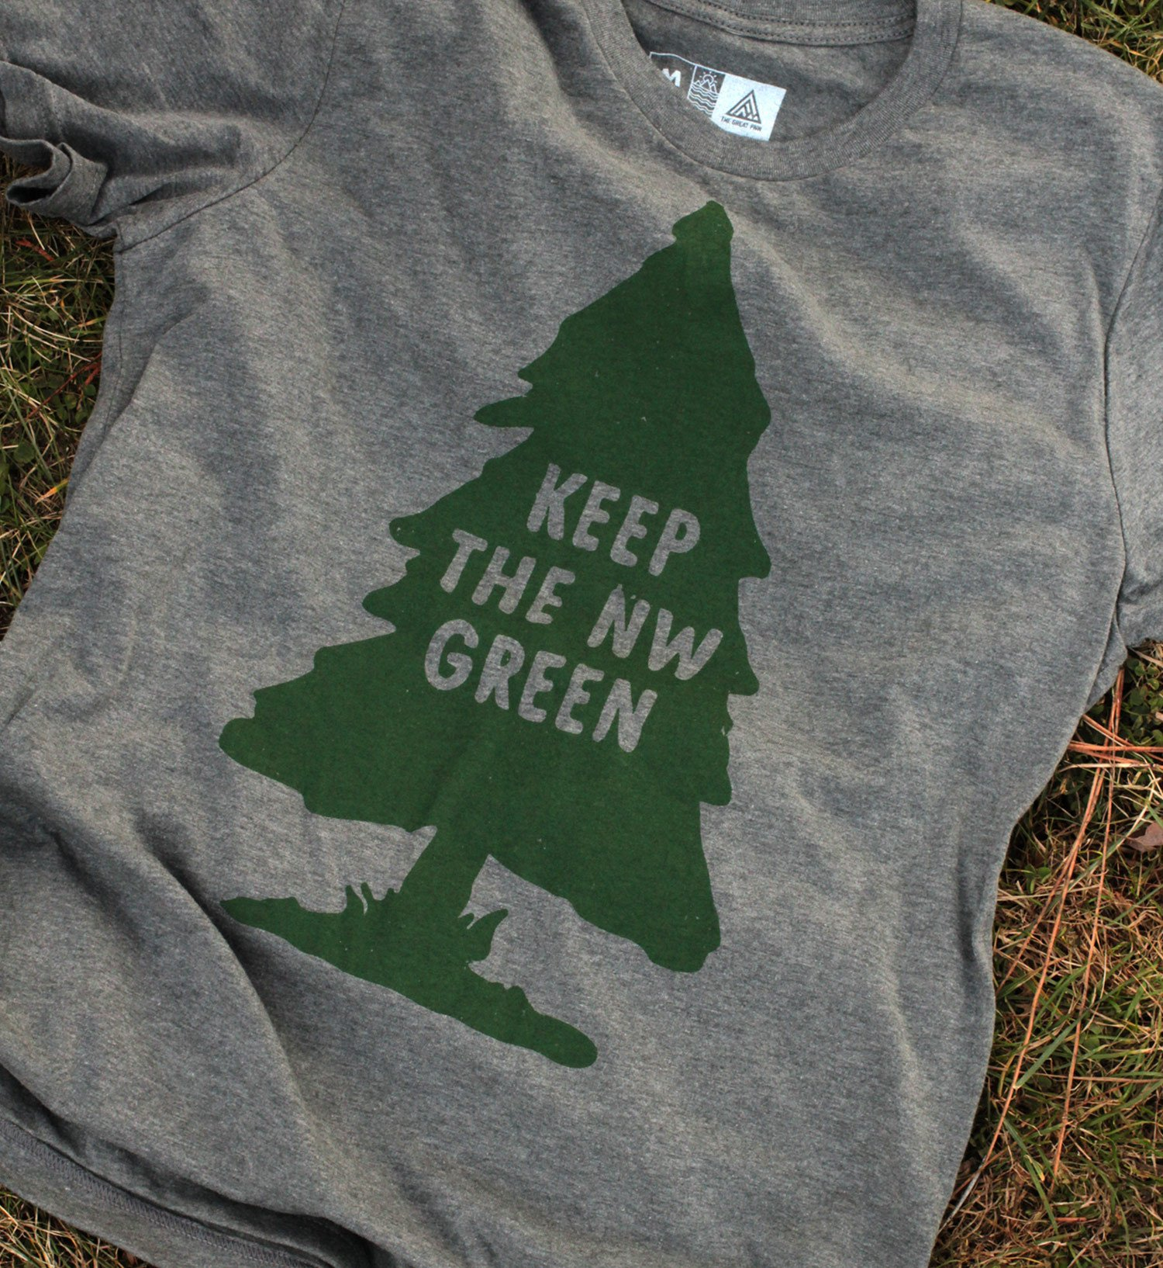
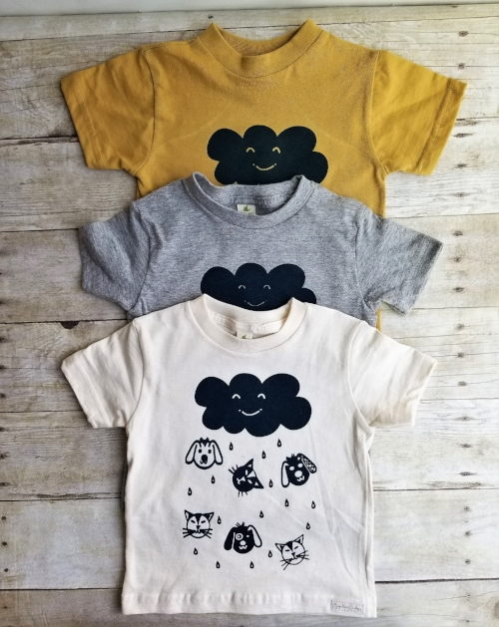
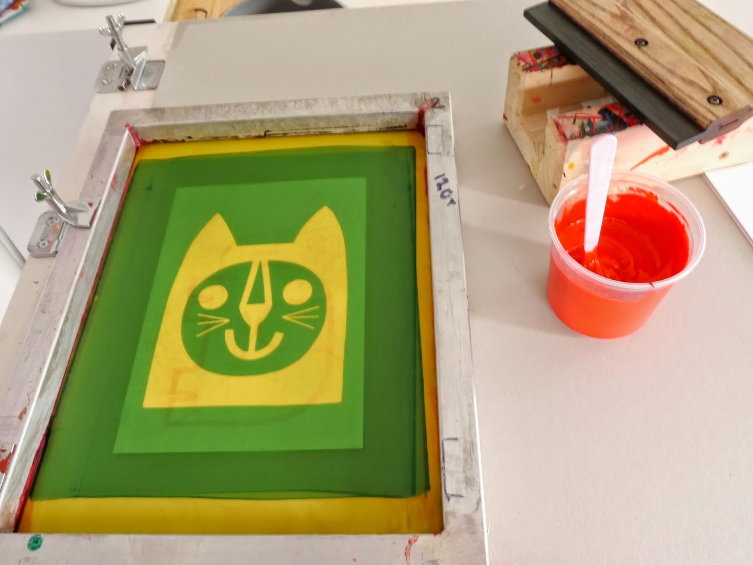
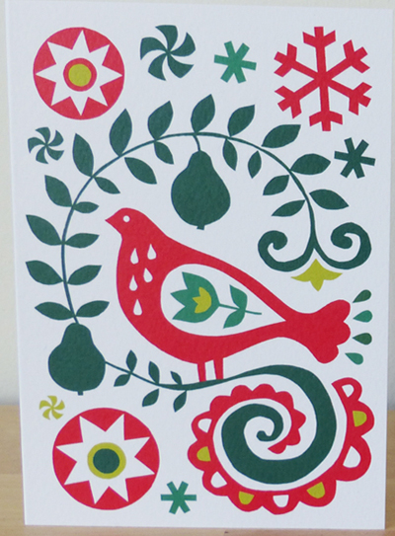
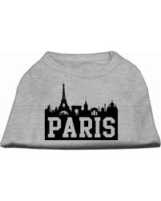
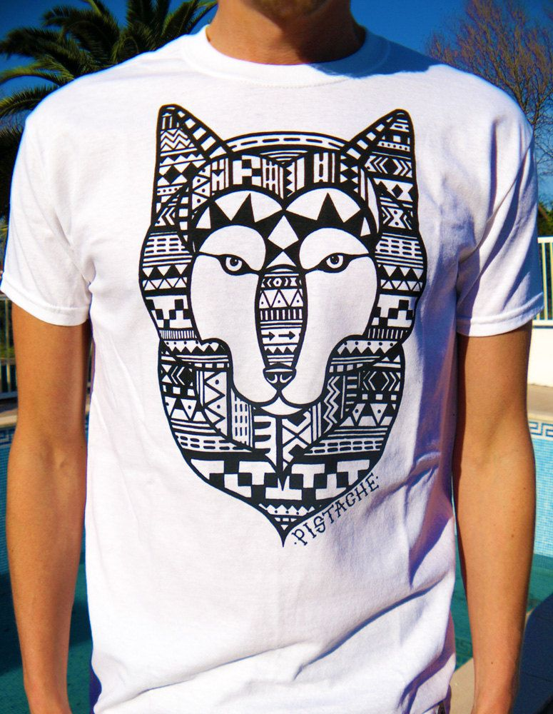
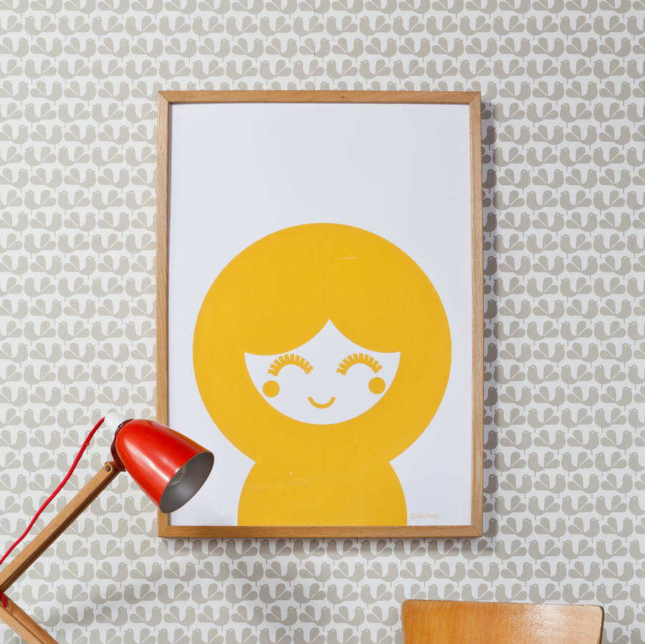
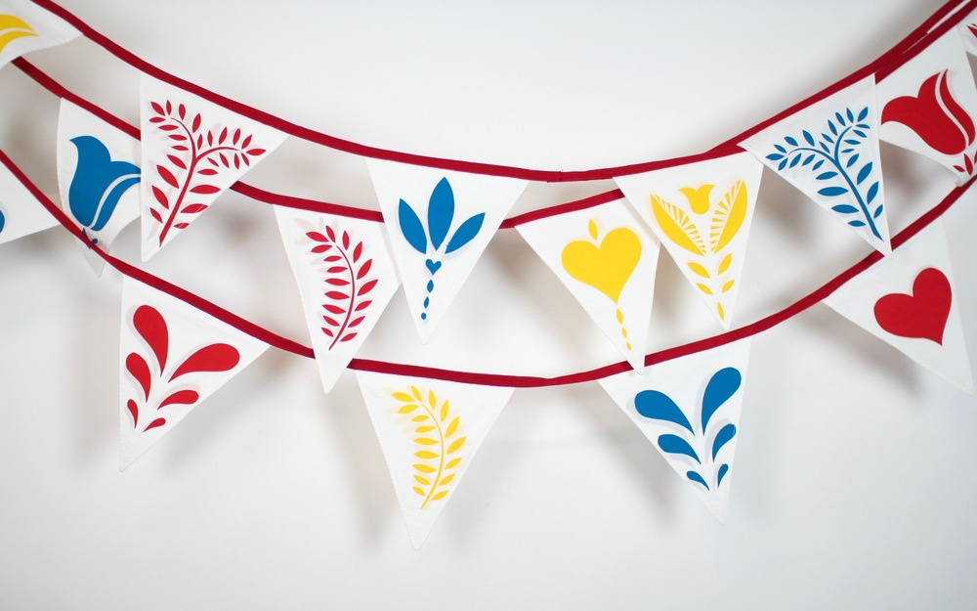

Slide 17
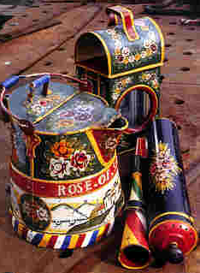
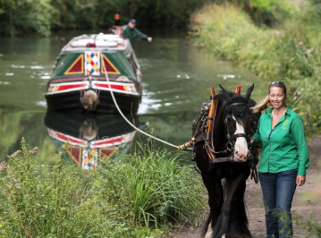
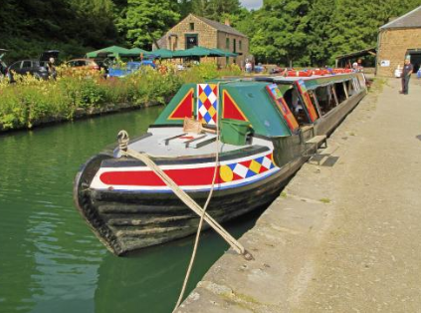
Or follow a design brief: Birdswood Trip Boat, Cromford Canal
Brief: Design a range of cards and notelets for sale in the visitor shop. These should be inspired by and reflect the canal, canal boat and its heritage on the Cromford Canal.

Slide 18
Design Brief: High Peak Junction, Railway Workshops
Brief: Design a range of bespoke souvenirs for sale in the visitor centre. This should include posters, postcards and could include badges, fridge magnets etc. Themes for design would include (but not restricted to):
The oldest railway workshops in the world
A railway linking 2 canals
A horse drawn railway
A railway with steep inclines, railway wharfs and catch pits for “the runaway” wagon
A canal with a working trip boat, Birdswood
A canal that is a Site of Special Scientific interest for its wildlife, water voles, dab chicks and water fowl
A working steam beam engine, Leawood Pump
Canal and railway artefacts and tools

Slide 19
Design Briefs: BELPER NORTH MILL
Window Vinyls for Belper North Mill:
Design 7 vinyl window covers which prevent viewing through the windows. These should use colours as outlined in the DVMWHS branding guidelines. The images on the vinyls should reflect the local area, in particular Belper and the DVMWHS. The dimensions should be 6 panels that are 27.5 inches high by 29cm wide, and one that is 27.5 inches high by 44cm wide.

